Slide 1
Day 6

Slide 2
Today’s agenda
Day | Topic | Chapter Details | Time Duration
Day 6 | the CASE | Basic CASE statements | 60 mins
 |  | CASE statements comparing column values
 |  | CASE statements comparing two column values part 2
 |  | Filtering your CASE statement
 |  | CASE WHEN with aggregate functions
 |  | COUNT using CASE WHEN
 |  | COUNT and CASE WHEN with multiple conditions
 |  | Calculating percent with CASE and AVG
 | 5 mins Break
 | dates and timestamps | Date/time types and formats | 60 mins
 |  | Date arithmetic
 |  | Completion time by category
 |  | Date/time components and aggregation
 |  | Variation by day of week
 |  | Date truncation
 |  | Aggregating with date/time series
 |  | Find missing dates
 |  | Custom aggregation periods

Slide 3
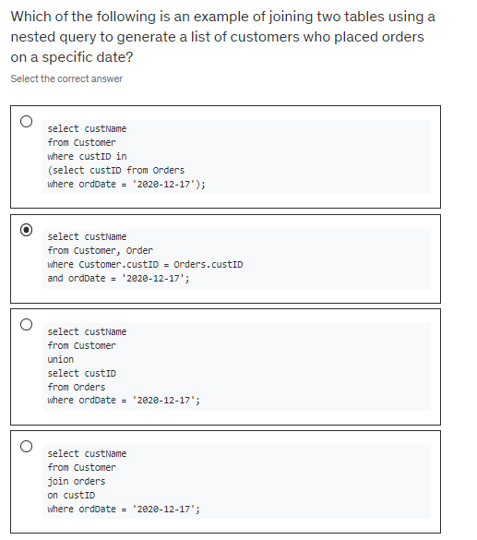

Slide 4
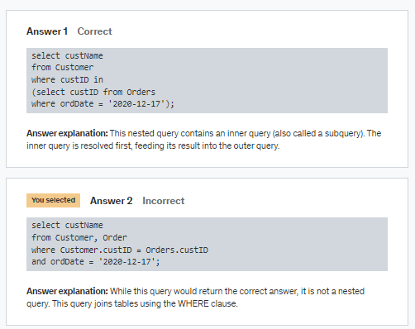

Slide 5
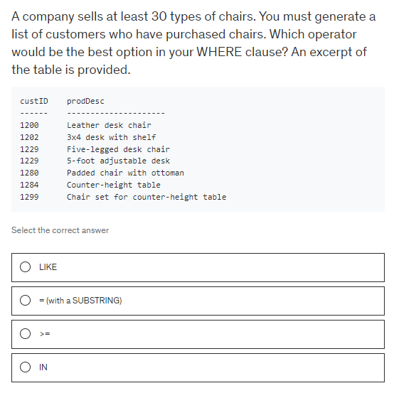

Slide 6
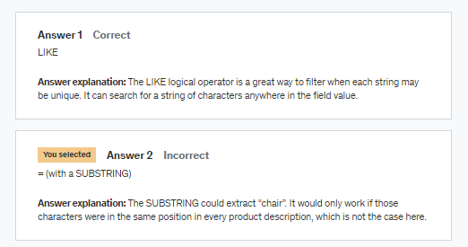

Slide 7
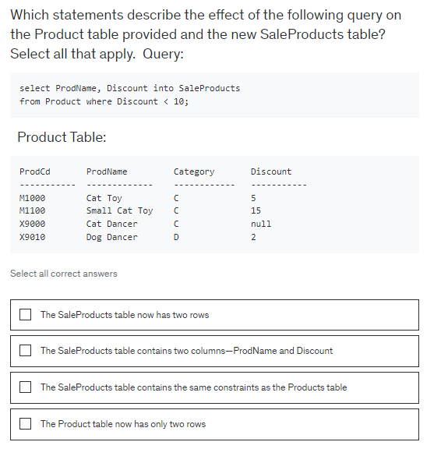

Slide 8
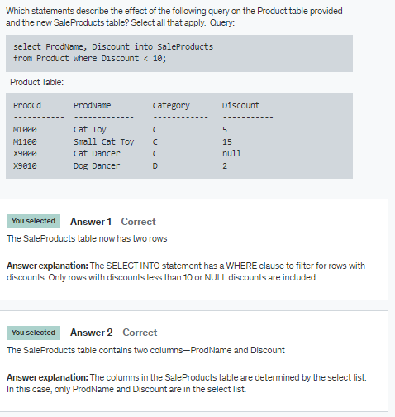

Slide 9
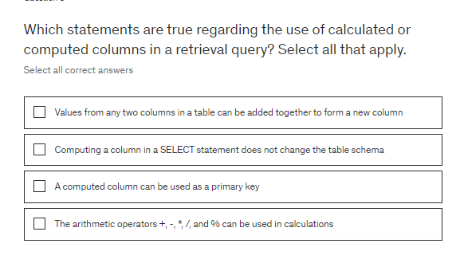

Slide 10
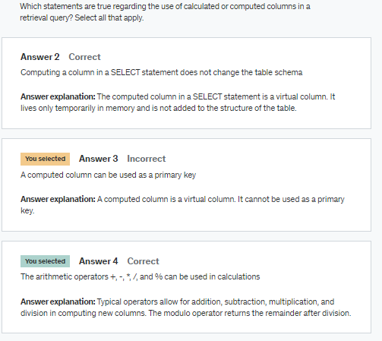

Slide 11
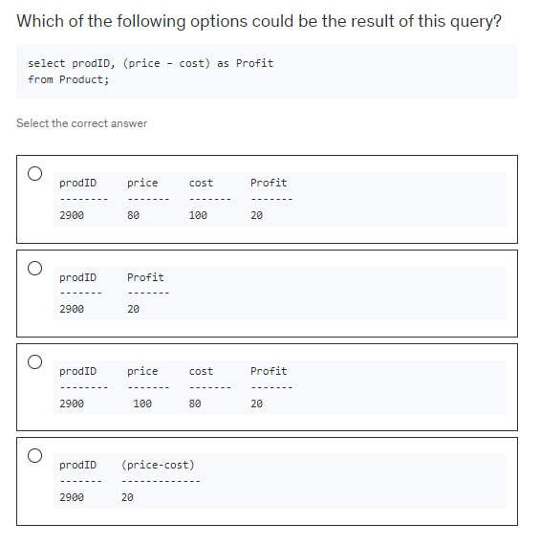

Slide 12
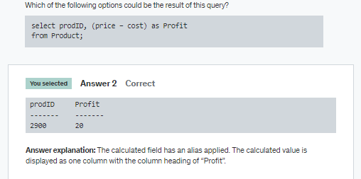

Slide 13
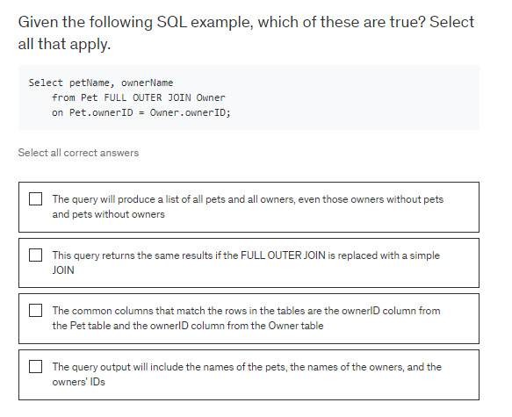

Slide 14
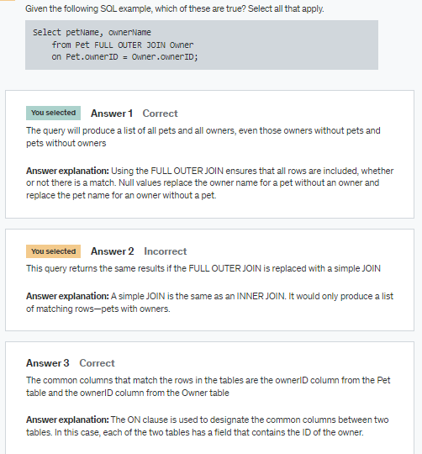

Slide 15
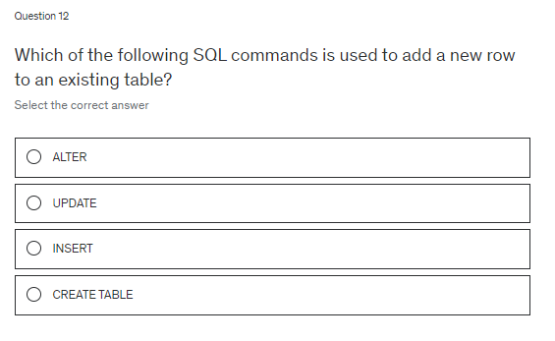

Slide 16
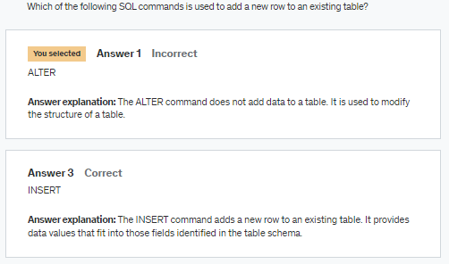

Slide 17
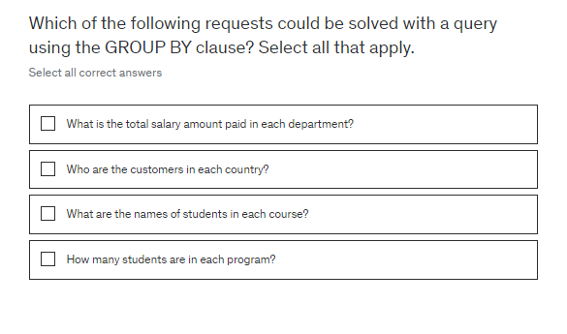

Slide 18
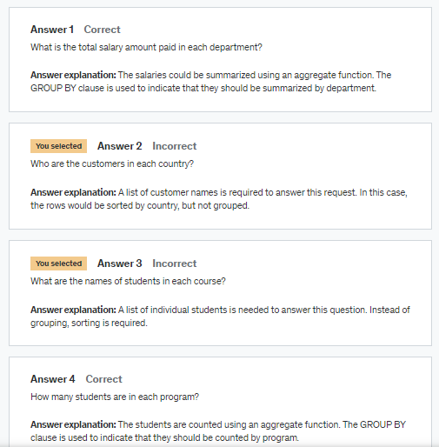

Slide 19
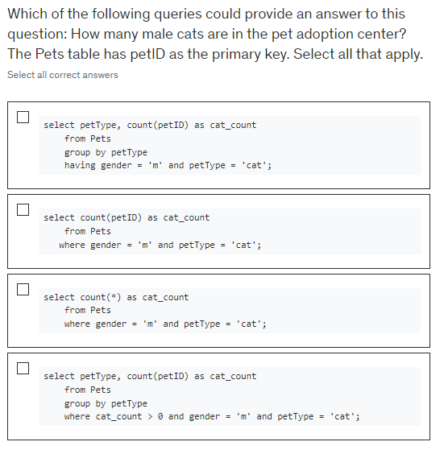

Slide 20
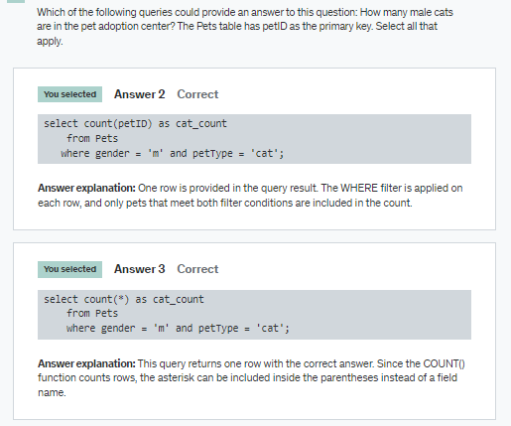

Slide 21
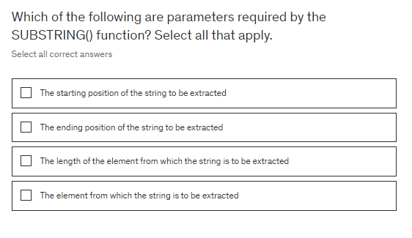

Slide 22
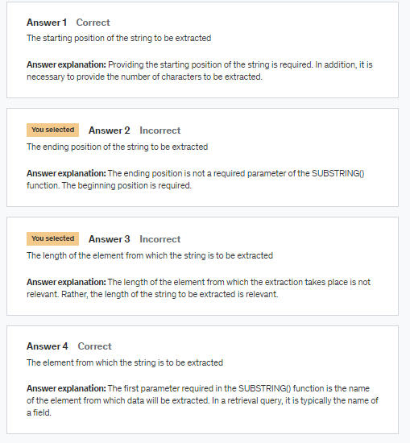

Slide 23
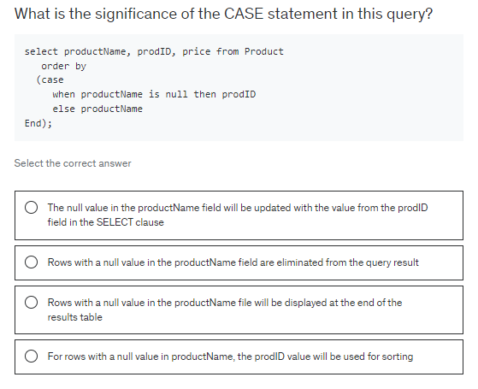

Slide 24
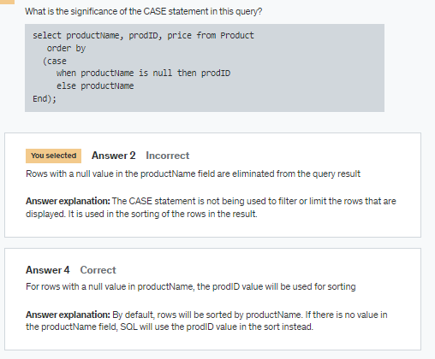

Slide 25
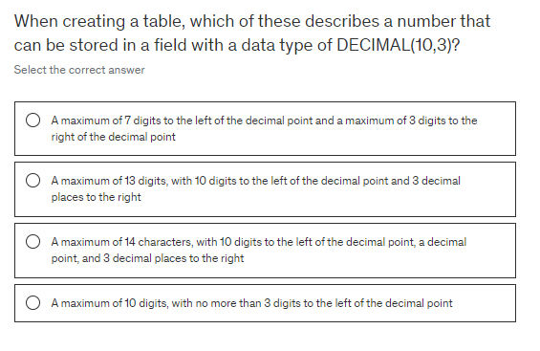

Slide 26
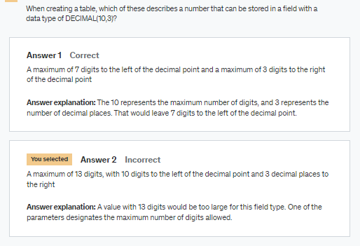

Slide 27
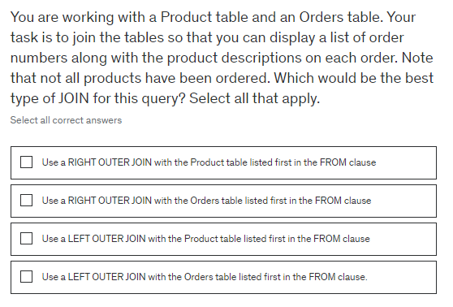

Slide 28
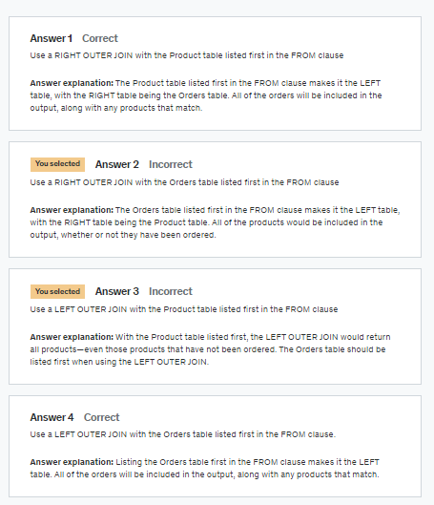

Slide 29
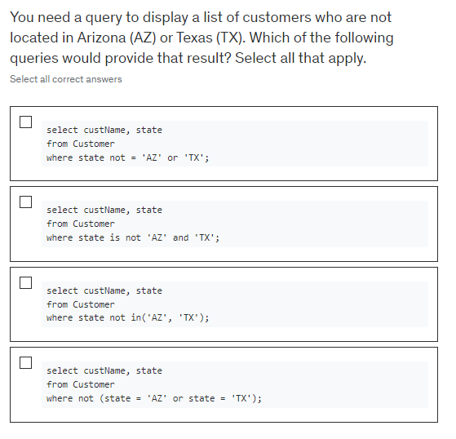

Slide 30
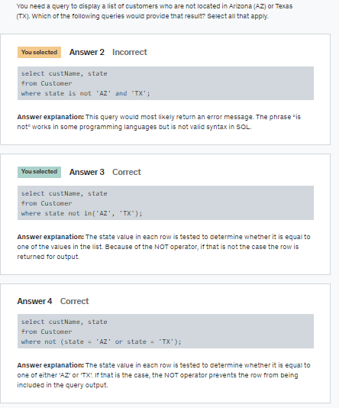

Slide 31
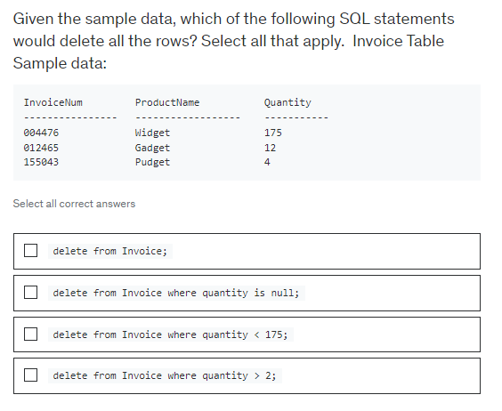

Slide 32
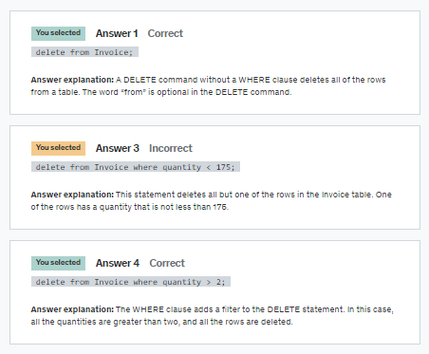

Slide 33
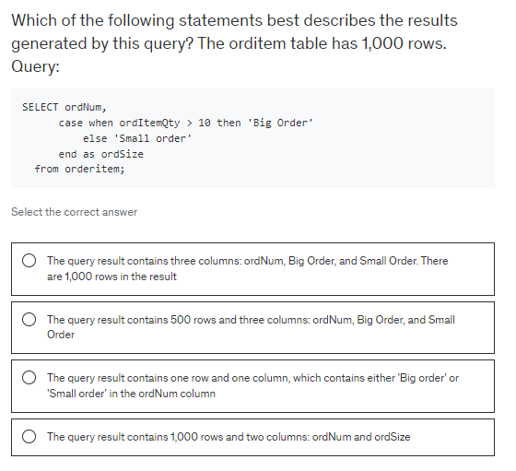

Slide 34
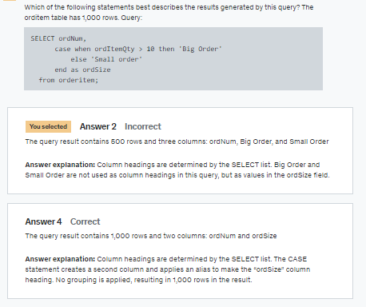

Slide 35


Slide 36


Slide 37
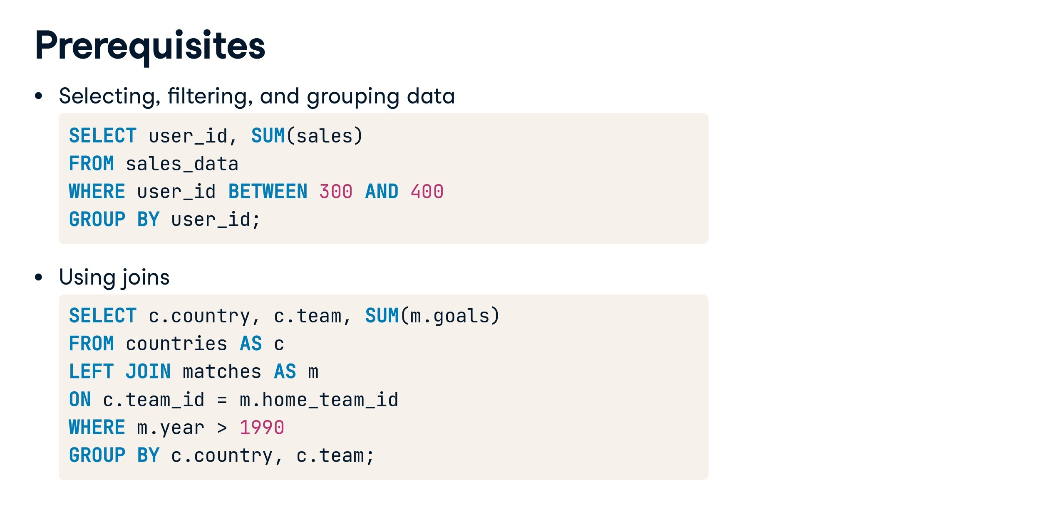

Slide 38
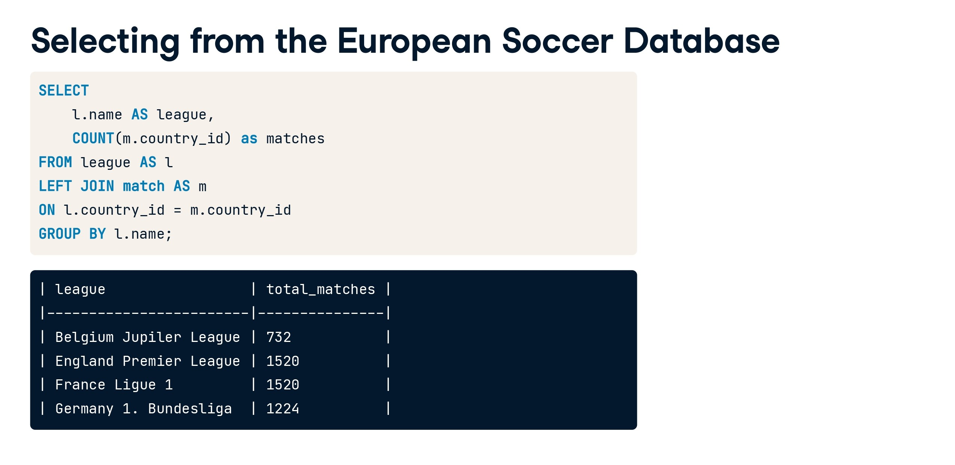

Slide 39
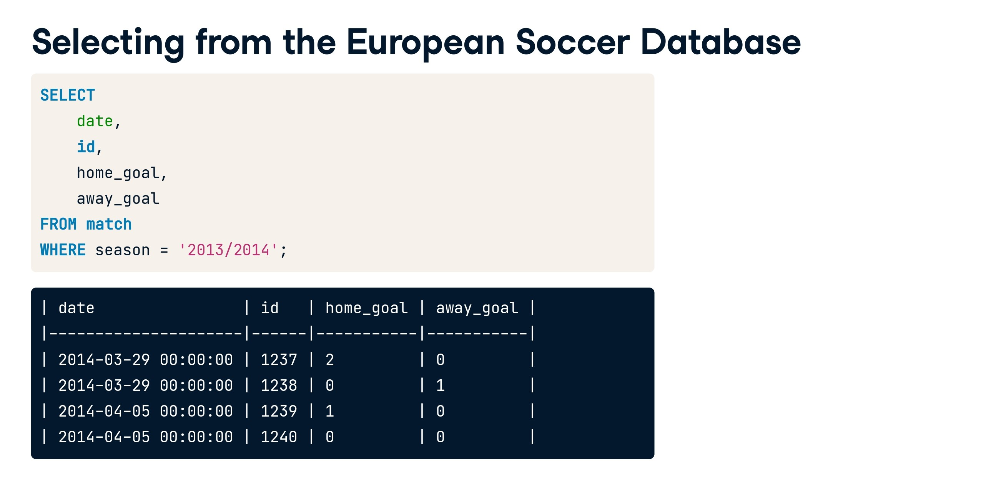

Slide 40
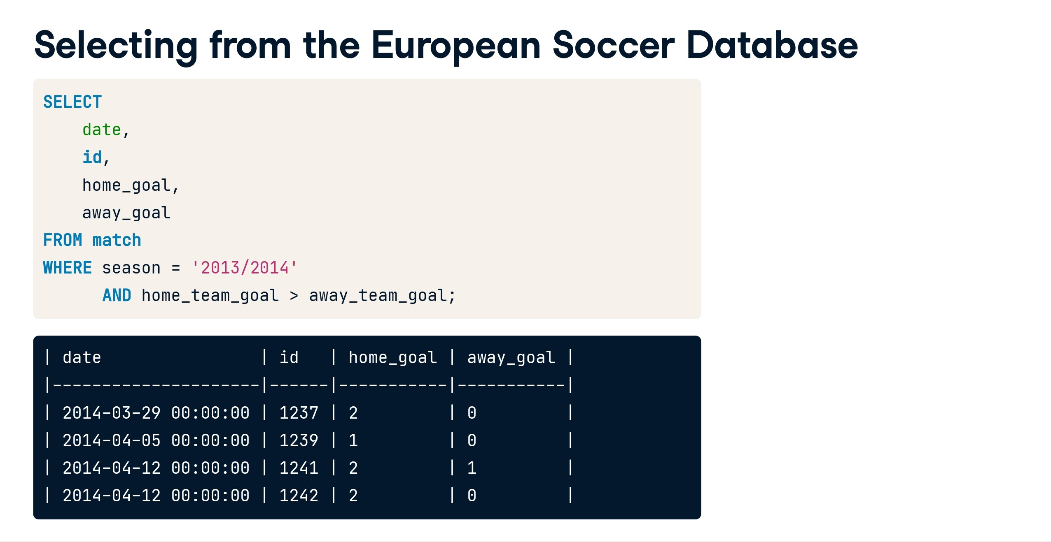

Slide 41
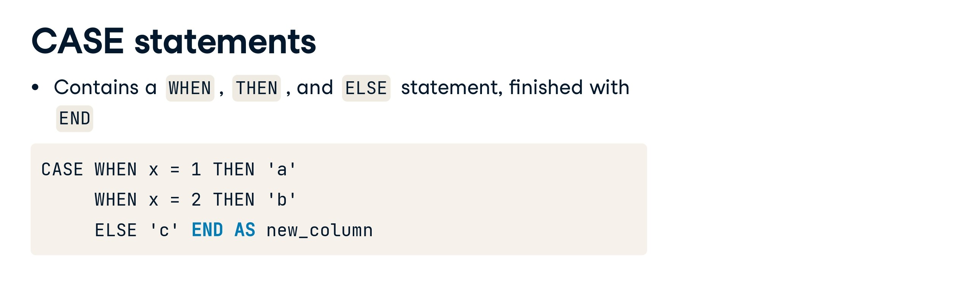

Slide 42
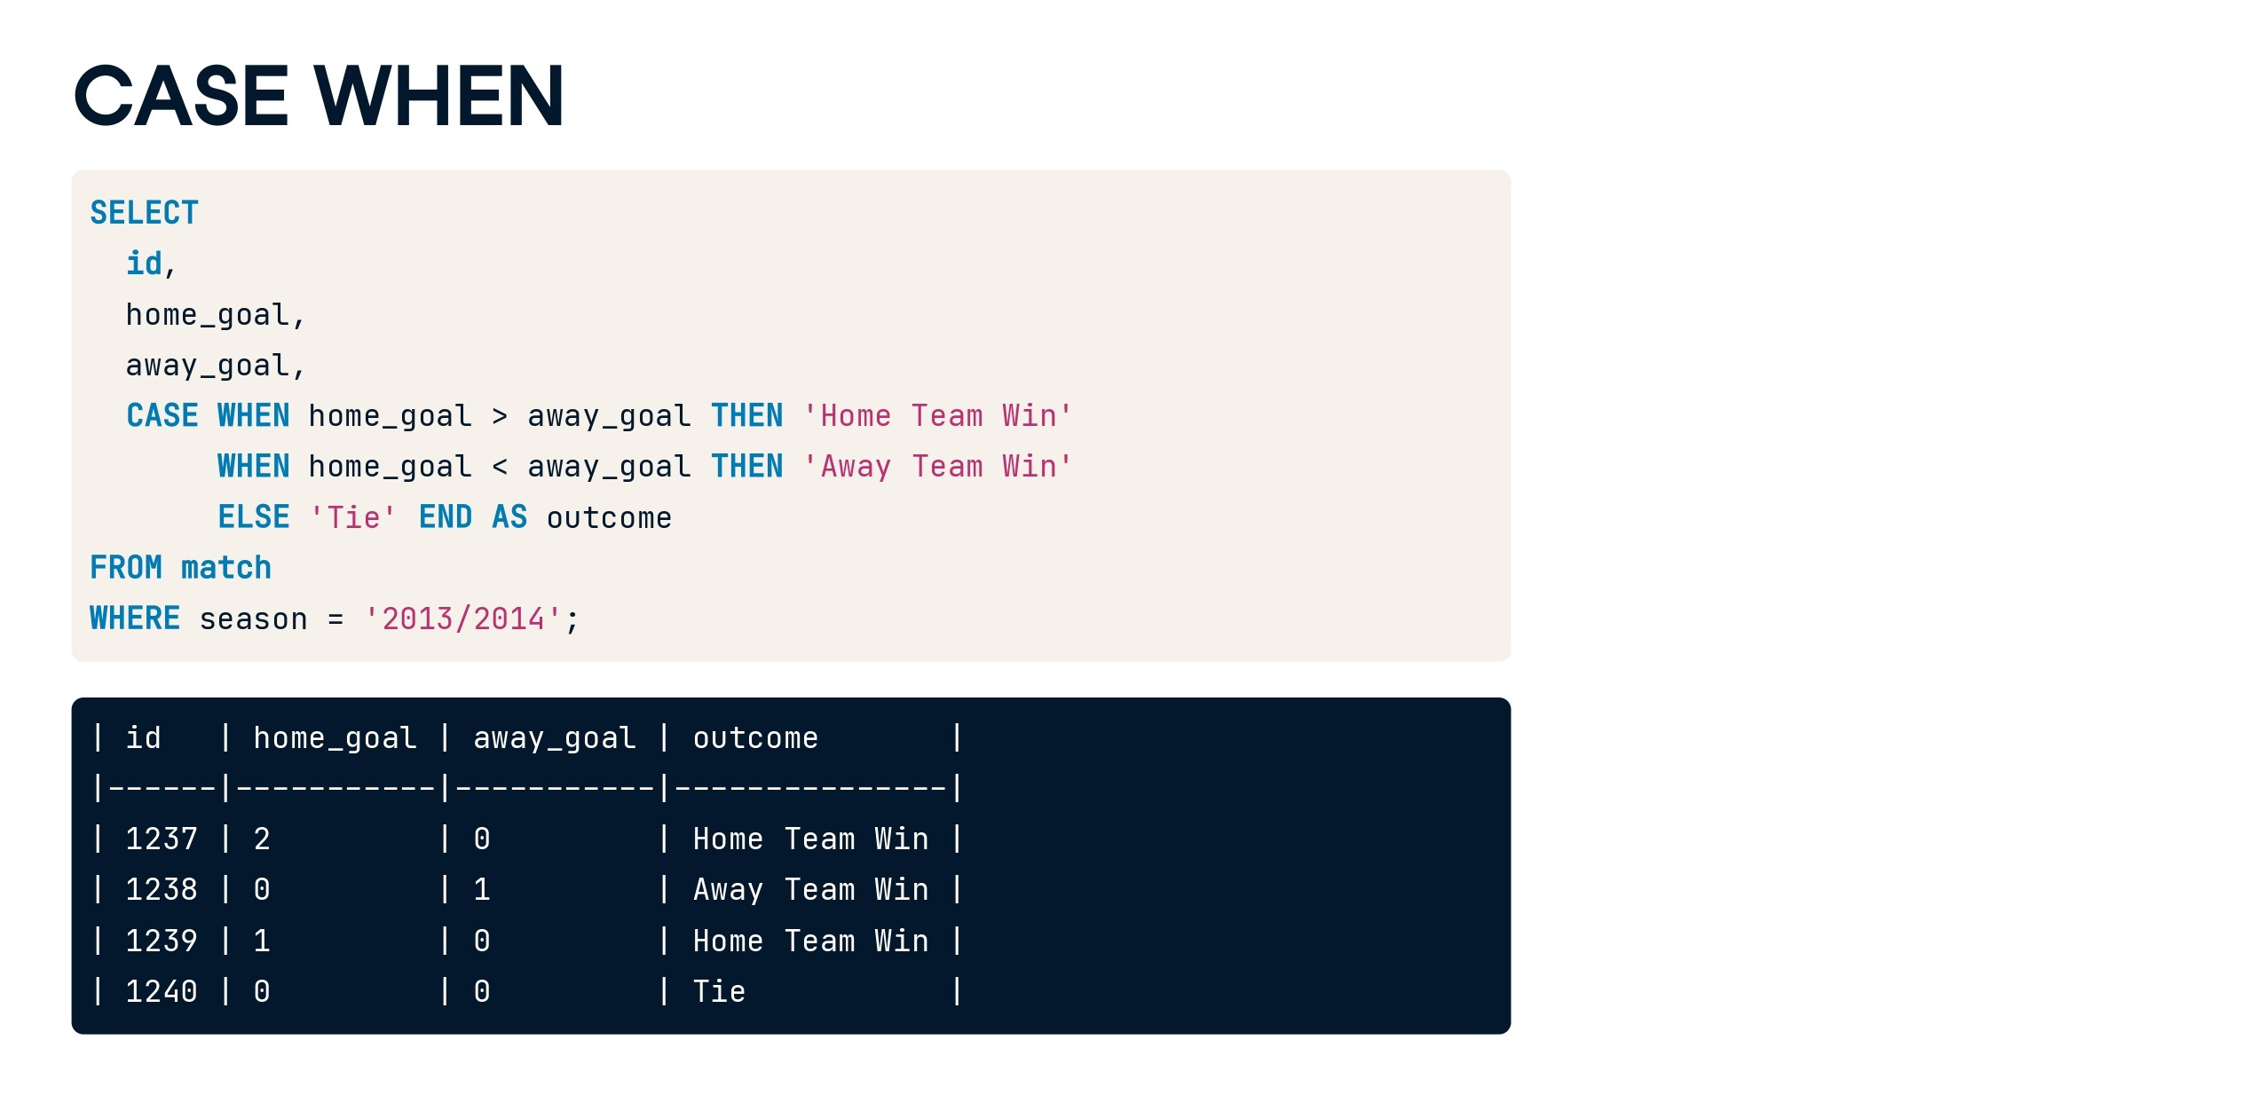

Slide 43


Slide 44
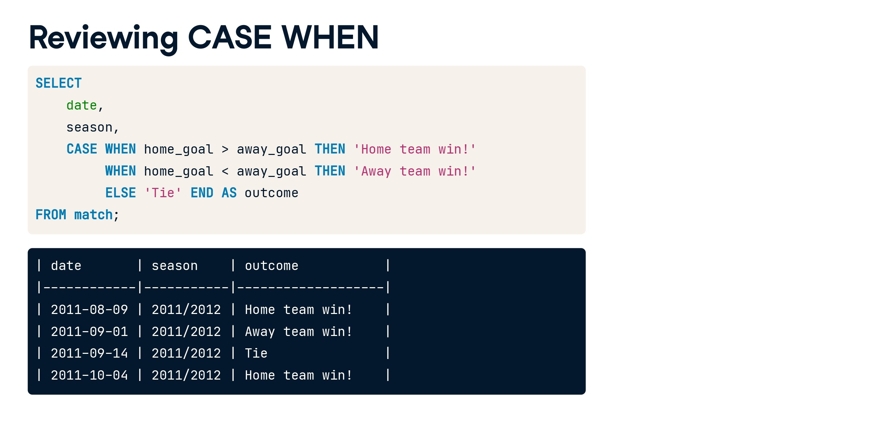

Slide 45
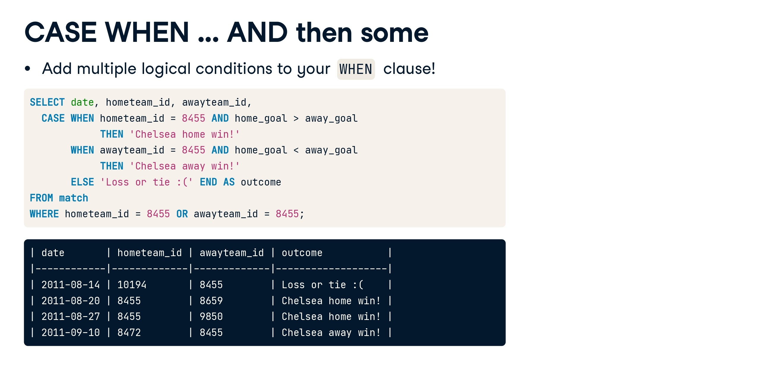

Slide 46
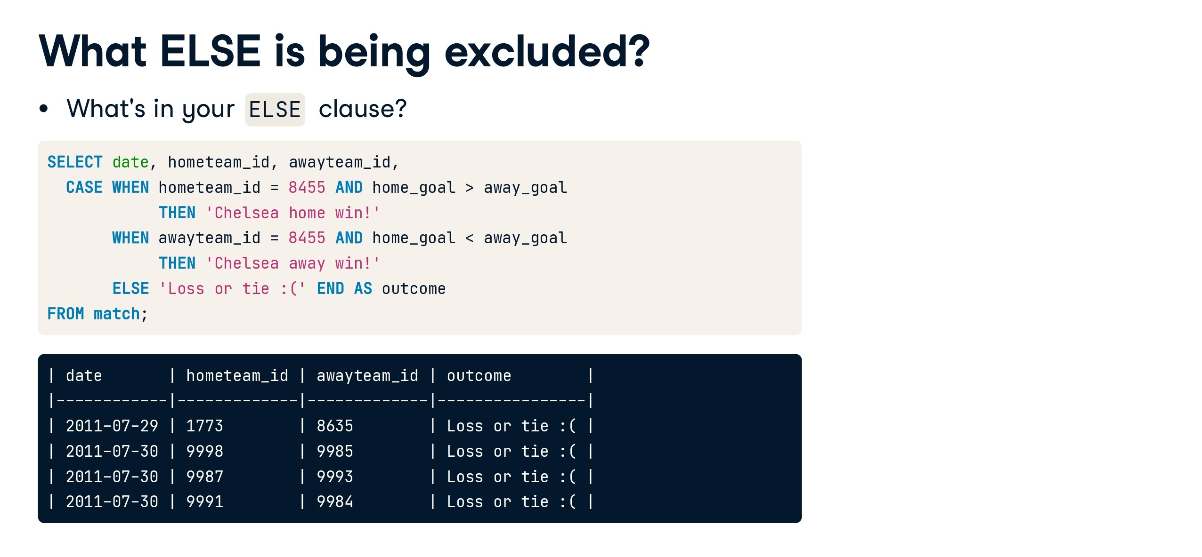

Slide 47
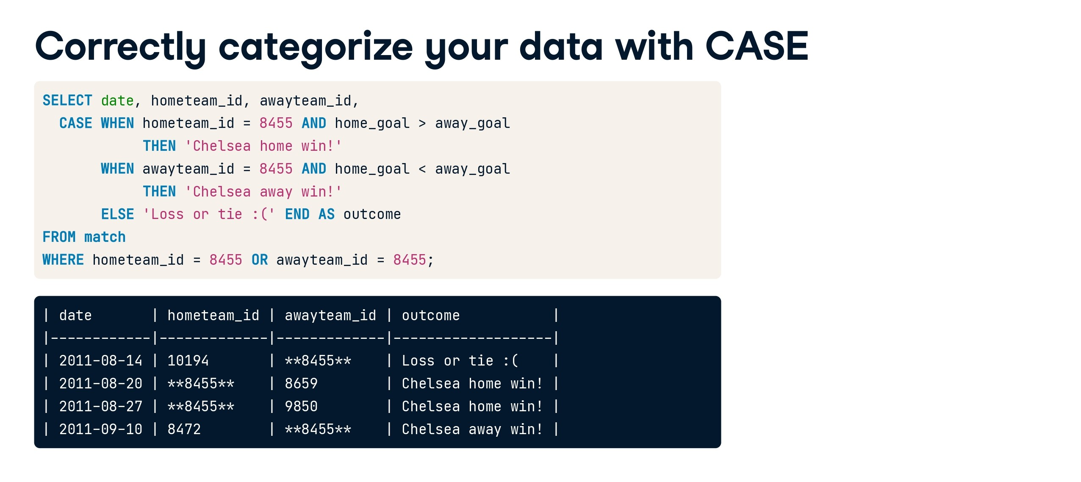

Slide 48
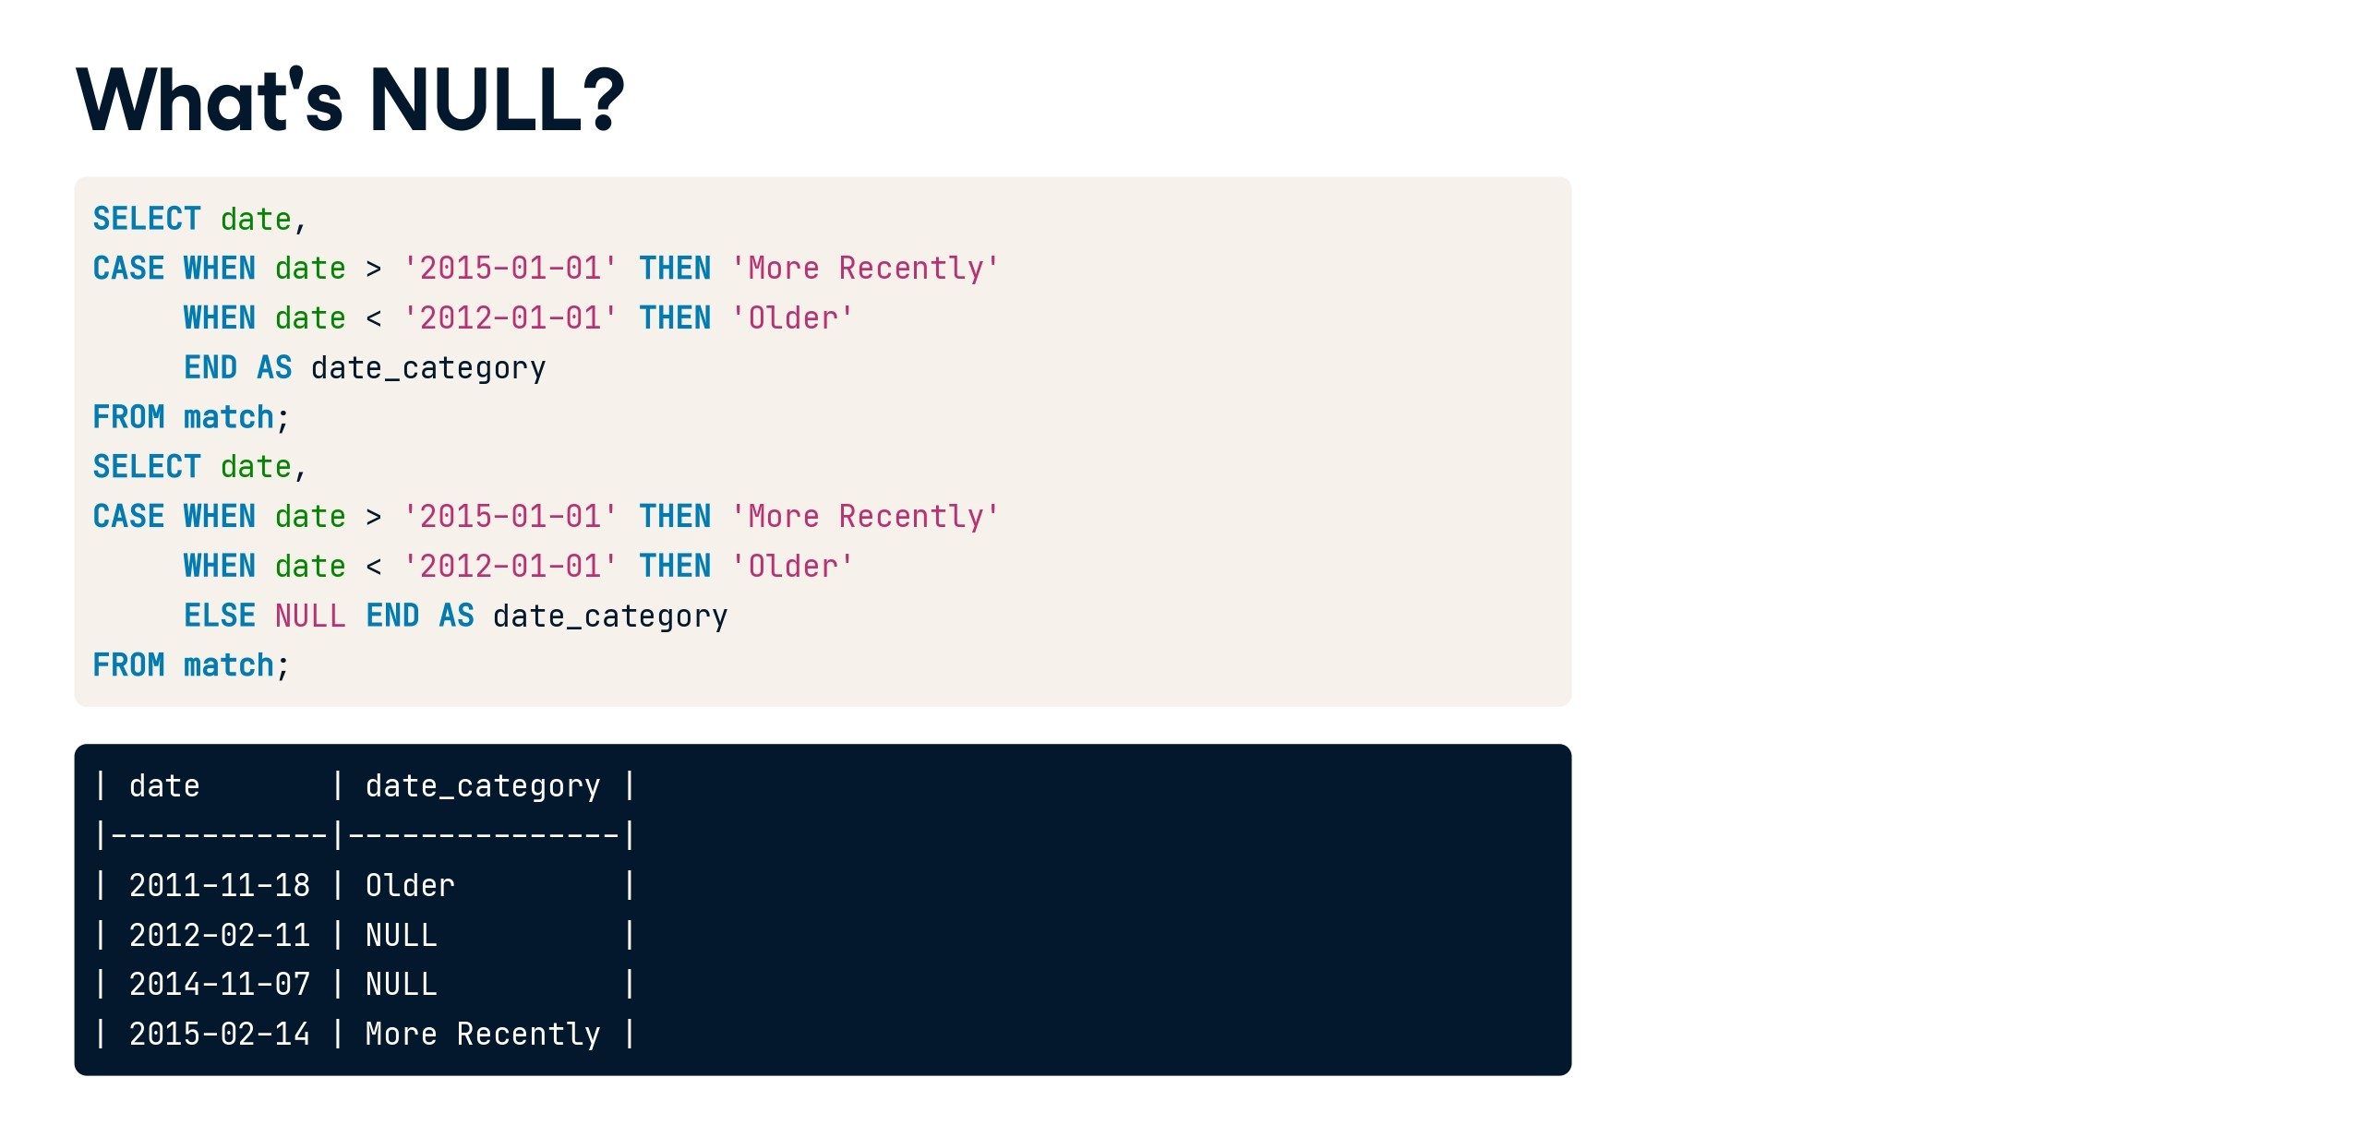

Slide 49
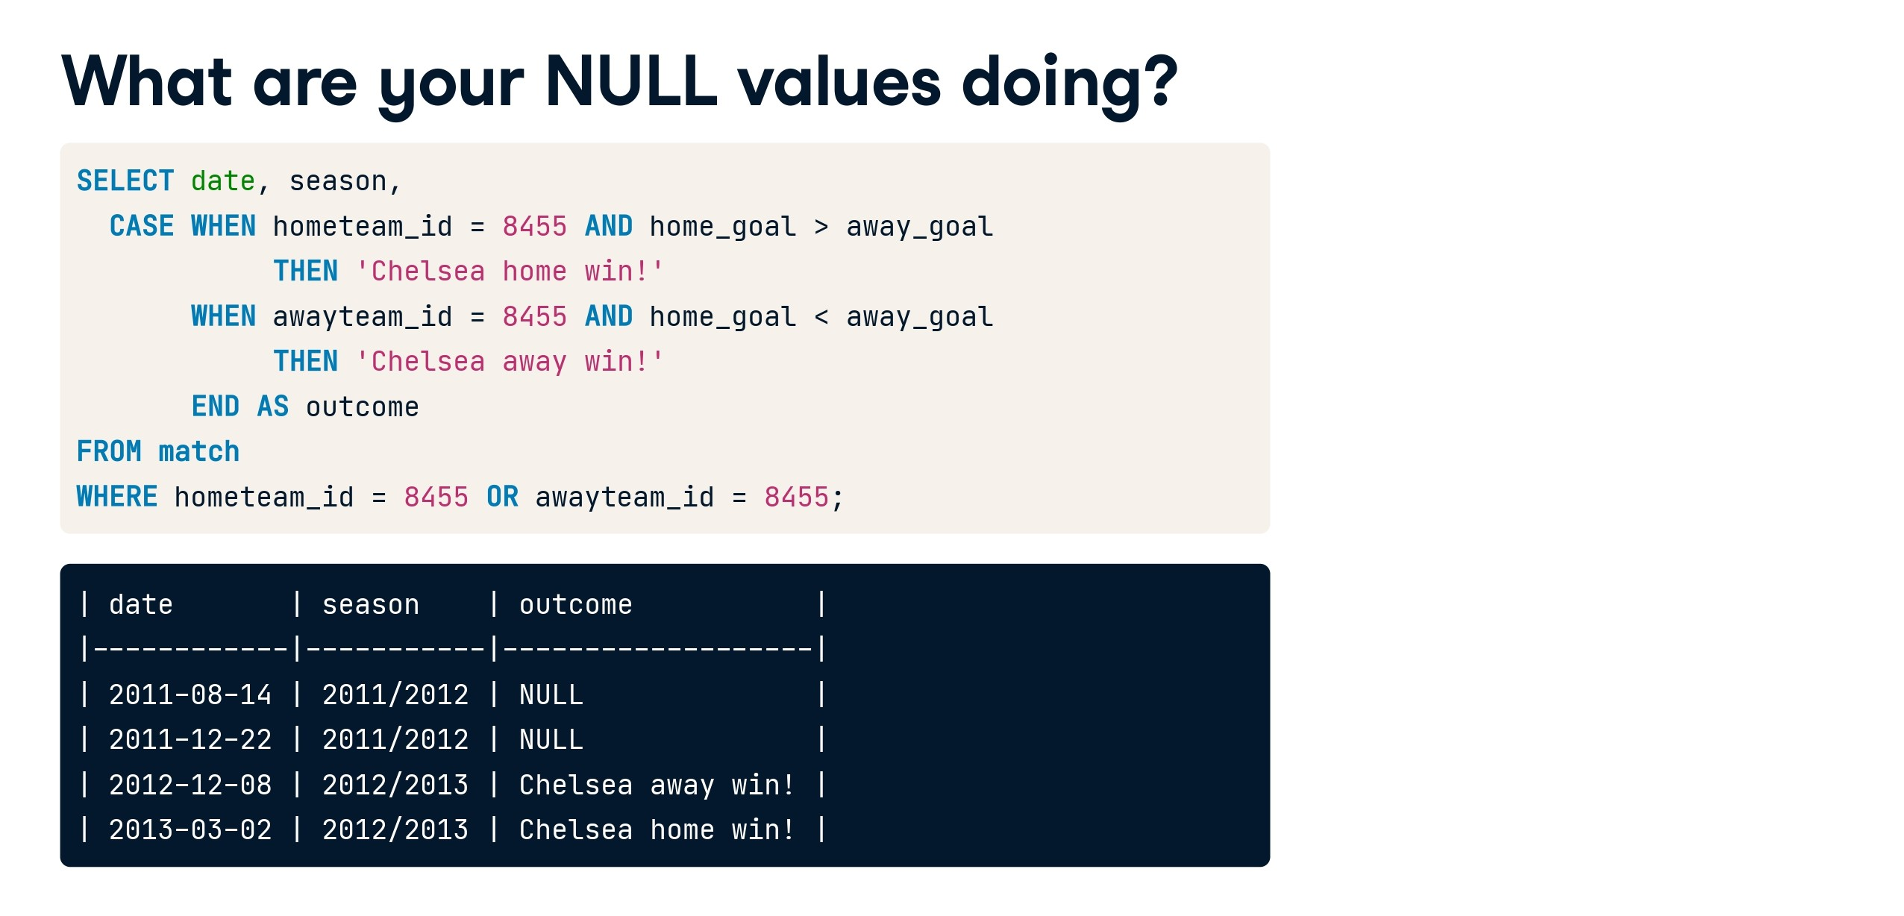

Slide 50
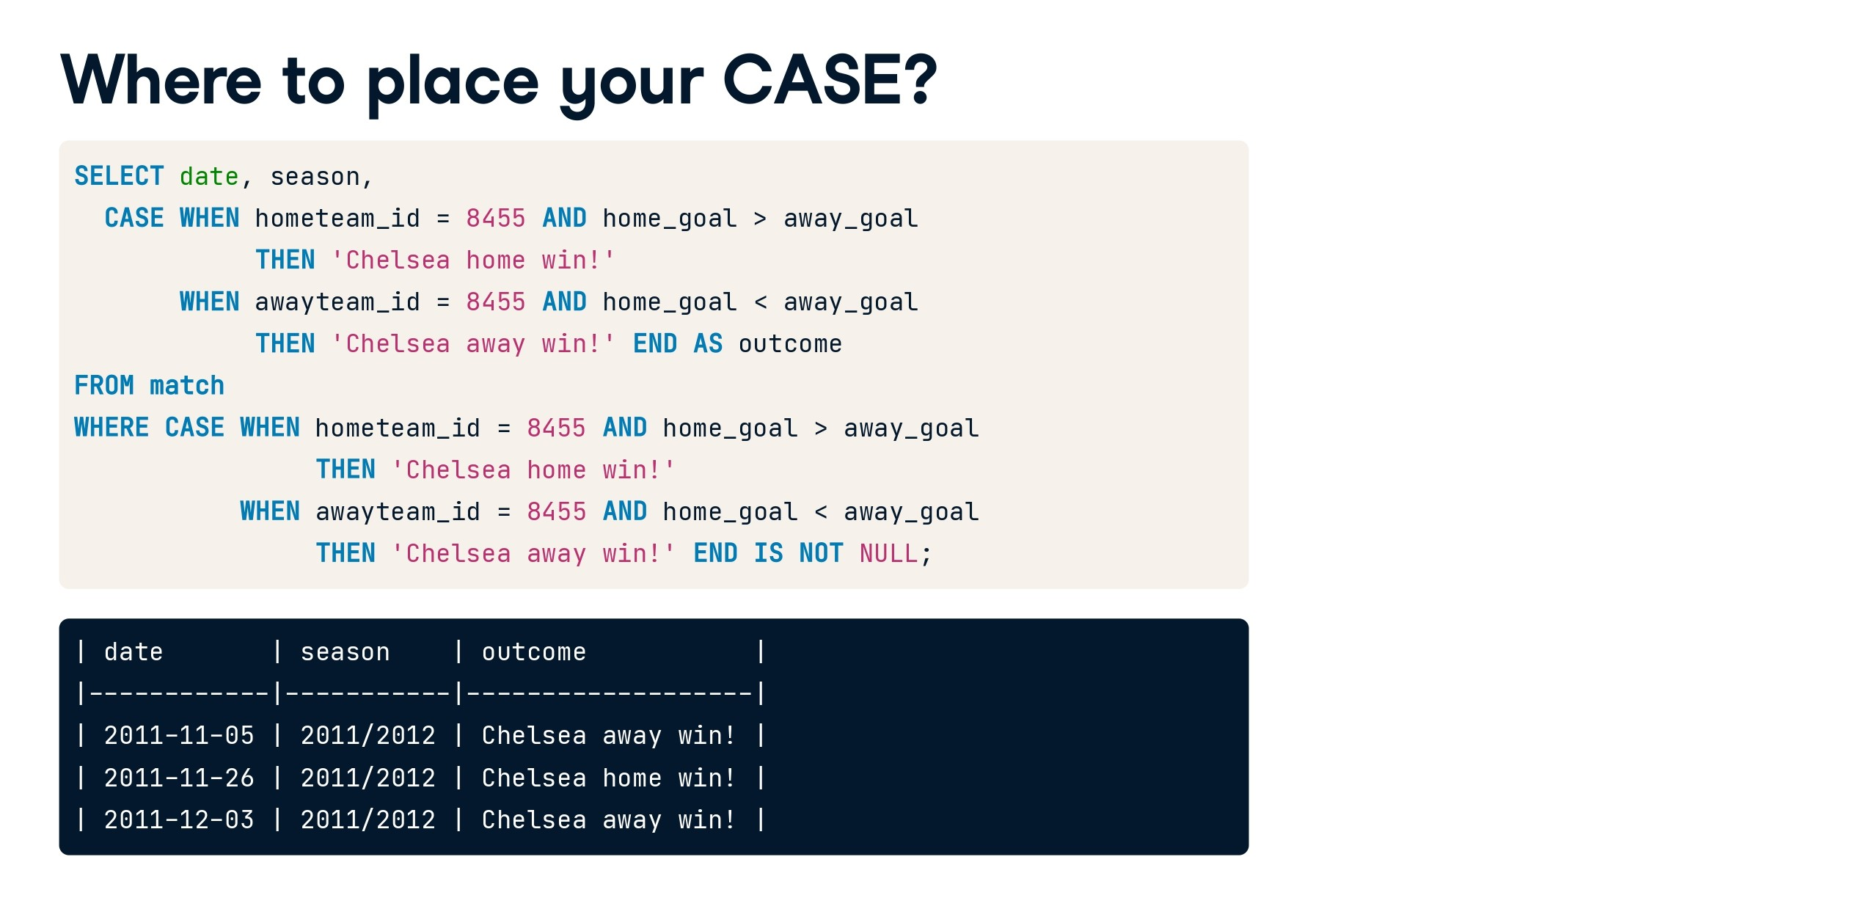

Slide 51


Slide 52
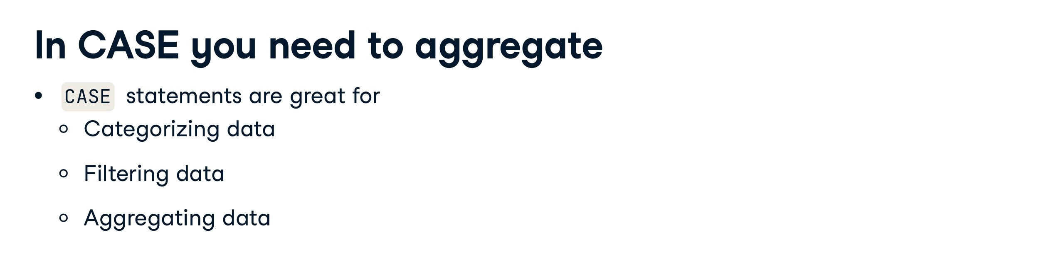

Slide 53
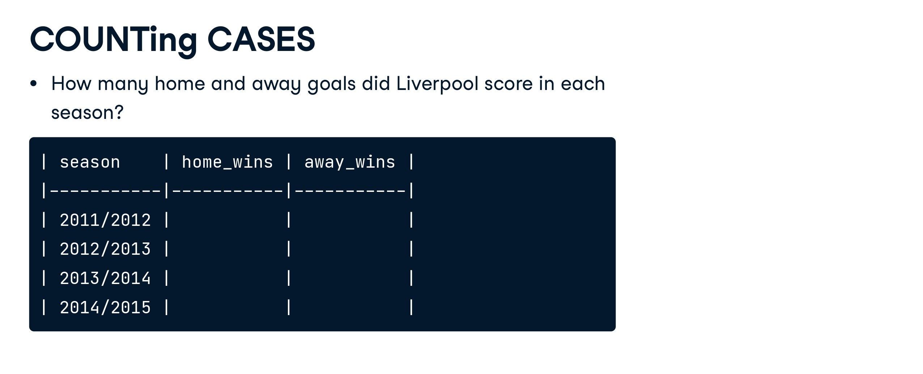

Slide 54
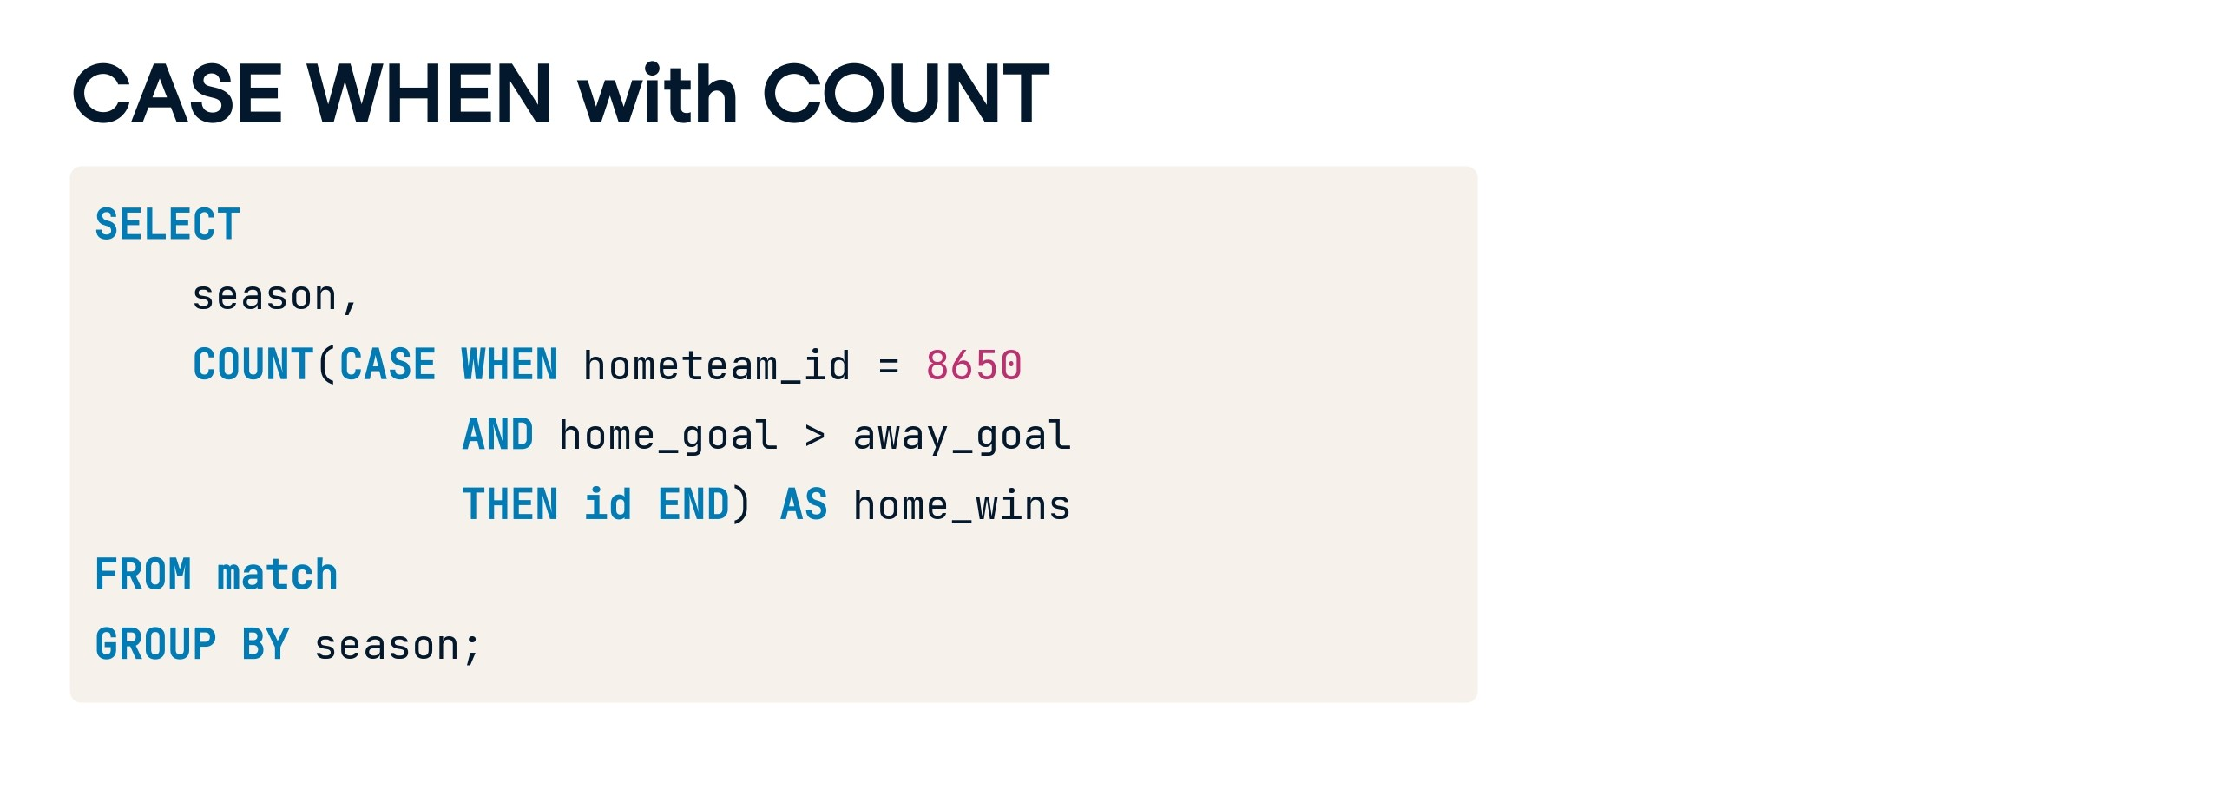

Slide 55
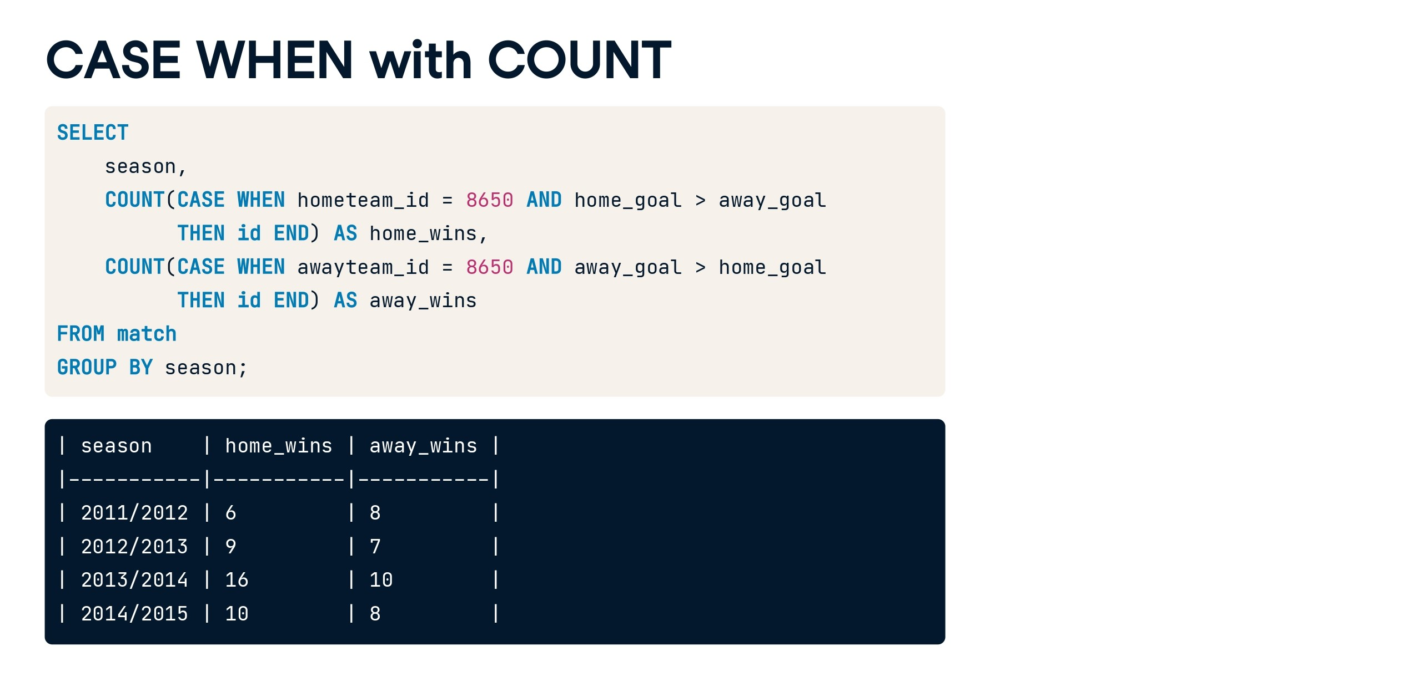

Slide 56
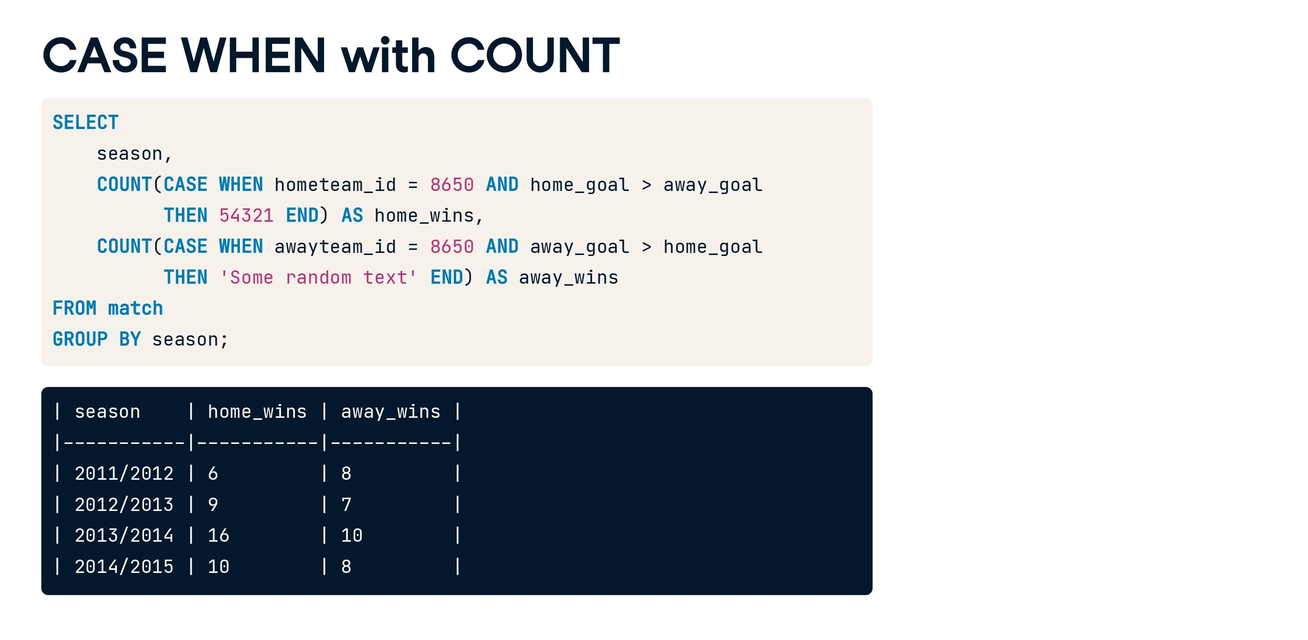

Slide 57


Slide 58


Slide 59


Slide 60


Slide 61


Slide 62


Slide 63


Slide 64
Offset, Fetch and top:
SELECT *
FROM [Sach].[dbo].[laptop]
order by ratings desc
offset 1 rows fetch next 10 rows only
SELECT *
FROM [Sach].[dbo].[laptop]
order by ratings
offset 2 rows fetch next 10 rows only
SELECT distinct *
FROM [Sach].[dbo].[laptop]
order by ratings
offset 2 rows fetch next 10 rows only
SELECT *
FROM [Sach].[dbo].[laptop]
order by ratings
offset 2 rows fetch first 10 rows only
-- Offset fetch is only used with order by clause
SELECT top 50 percent *
FROM [Sach].[dbo].[laptop]
SELECT top 2 with ties *
FROM [Sach].[dbo].[laptop]
order by ratings desc

Slide 65
SELECT CURRENT_TIMESTAMP;
SELECT getdate();
SELECT sysdatetime();
SELECT SYSDATETIMEOFFSET();
CURRENT_TIMESTAMP:
CURRENT_TIMESTAMP is an ANSI SQL standard way to obtain the current date and time.
It can be used in SQL Server as well as in many other database systems.
The precision of the timestamp may vary depending on the specific database system, but it typically includes seconds.
getdate():
getdate() is specific to Microsoft SQL Server.
It also retrieves the current date and time but includes milliseconds for higher precision.

Slide 66
INSERT INTO [tele].[dbo].[CallCenter]
([CustomerID], [AgentID], [StartTime], [EndTime], [CallDuration], [CallStatus], [Notes], [Name], [FathersName], [SpouseName])
VALUES
-- Record 1
(1, 101, '2024-01-16 08:00:00', '2024-01-16 08:30:00', 30, 'Completed', 'Random notes 1', 'John Doe', 'John Doe Sr.', 'Jane Doe'),
-- Record 2
(2, 102, '2024-01-16 09:00:00', '2024-01-16 09:45:00', 45, 'In Progress', 'Random notes 2', 'Jane Smith', 'John Smith Sr.', 'Jack Smith'),
-- Record 3
(3, 103, '2024-01-16 10:30:00', '2024-01-16 11:15:00', 45, 'Completed', 'Random notes 3', 'Bob Johnson', 'Bob Johnson Sr.', 'Betty Johnson'),
-- Record 4
(4, 101, '2024-01-16 08:00:00', '2024-01-16 08:30:00', 30, 'Completed', 'Random notes 1', 'John Doe', 'John Doe Sr.', 'Jane Doe'),
-- Record 5
(5, 102, '2024-01-16 09:00:00', '2024-01-16 09:45:00', 45, 'In Progress', 'Random notes 2', 'Jane Smith', 'John Smith Sr.', 'Jack Smith'),
-- Record 6
(6, 103, '2024-01-16 10:30:00', '2024-01-16 11:15:00', 45, 'Completed', 'Random notes 3', 'Bob Johnson', 'Bob Johnson Sr.', 'Betty Johnson'),
-- Record 7
(7, 101, '2024-01-16 08:00:00', '2024-01-16 08:30:00', 30, 'Completed', 'Random notes 1', 'John Doe', 'John Doe Sr.', 'Jane Doe'),
-- Record 8
(8, 102, '2024-01-16 09:00:00', '2024-01-16 09:45:00', 45, 'In Progress', 'Random notes 2', 'Jane Smith', 'John Smith Sr.', 'Jack Smith'),
-- Record 9
(9, 103, '2024-01-16 10:30:00', '2024-01-16 11:15:00', 45, 'Completed', 'Random notes 3', 'Bob Johnson', 'Bob Johnson Sr.', 'Betty Johnson'),
-- Record 10
(25, 125, '2024-01-16 18:00:00', '2024-01-16 18:45:00', 45, 'Completed', 'Random notes 25', 'Michael Davis', 'Michael Davis Sr.', 'Megan Davis');
CREATE TABLE [tele].[dbo].[CallCenter] (
[CallID] INT PRIMARY KEY,
[CustomerID] INT,
[AgentID] INT,
[StartTime] DATETIME,
[EndTime] DATETIME,
[CallDuration] INT,
[CallStatus] VARCHAR(255),
[Notes] TEXT,
[Name] VARCHAR(255),
[FathersName] VARCHAR(255),
[SpouseName] VARCHAR(255)
);

Slide 67
INSERT INTO Product (ProductID, SellStartDate)
VALUES
(1001, '2024-01-17'), -- ProductID 1001 and date for the first row
(1002, '2024-02-15'), -- ProductID 1002 and date for the second row
(1003, '2024-03-20'), -- ProductID 1003 and date for the third row
(1004, '2024-01-17'), -- ProductID 1001 and date for the first row
(1005, '2024-02-15'), -- ProductID 1002 and date for the second row
(1006, '2024-03-20'), -- ProductID 1003 and date for the third row
(1007, '2024-01-17'), -- ProductID 1001 and date for the first row
(1008, '2024-02-15'), -- ProductID 1002 and date for the second row
(1009, '2024-03-20'); -- ProductID 1003 and date for the third row
CREATE TABLE Product (
ProductID INT,
SellStartDate DATE
);

Slide 68
SELECT CustomerID, datename(month,Starttime) AS Extractmonth
FROM CallCenter;
SELECT CustomerID,eomonth(Starttime) AS Extractmonth
FROM CallCenter;
SELECT ProductID, SellStartDate,datepart(month,sellstartdate) AS Extractmonth
FROM Product;
SELECT ProductID, SellStartDate,day(sellstartdate) AS ExtractDay
FROM Product;
SELECT ProductID, SellStartDate,month(sellstartdate) AS ExtractMonth
FROM Product;
SELECT ProductID, SellStartDate,year(sellstartdate) AS ExtractYear
FROM Product;

Slide 69
SELECT ProductID, SellStartDate,dateadd(yyyy,3,sellstartdate) AS NewSellStartDate
FROM Product;
SELECT ProductID, SellStartDate,dateadd(q,3,sellstartdate) AS NewSellStartDate
FROM Product;
SELECT ProductID, SellStartDate,dateadd(m,3,sellstartdate) AS NewSellStartDate
FROM Product;
SELECT ProductID, SellStartDate,dateadd(d,3,sellstartdate) AS NewSellStartDate
FROM Product;
SELECT ProductID, SellStartDate,dateadd(hh,3,sellstartdate) AS NewSellStartDate
FROM Product;
SELECT ProductID, SellStartDate,dateadd(n,50,sellstartdate) AS NewSellStartDate
FROM Product;
SELECT ProductID, SellStartDate,dateadd(s,10,sellstartdate) AS NewSellStartDate
FROM Product;
SELECT ProductID, SellStartDate,SellEndDate, dateadd(ms,50,sellstartdate) AS NewSellStartDate
FROM Product;
SELECT ProductID, SellStartDate,SellEndDate, dateadd(m,50,sellstartdate) AS NewSellStartDate
FROM Product;
SELECT ProductID, SellStartDate,SellEndDate, datediff(yyyy,sellstartdate,sellenddate) AS diffDate
FROM Product;
SELECT ProductID, SellStartDate,SellEndDate, datediff(q,sellstartdate,sellenddate) AS diffDate
FROM Product;
SELECT ProductID, SellStartDate,SellEndDate, datediff(q,sellstartdate,sellenddate) AS diffDate
FROM Product
WHERE SellEndDate IS NOT NULL;

Slide 70


Slide 71


Slide 72


Slide 73


Slide 74


Slide 75
Views
-- Create a view for the CallCenter table
CREATE VIEW vwCallCenter AS
SELECT
CallID,
CustomerID,
AgentID,
StartTime,
EndTime,
CallDuration,
CallStatus,
Notes
FROM CallCenter;
-- Create a view for the Customer table
CREATE VIEW vwCustomer AS
SELECT
CustomerID,
FirstName,
LastName,
PhoneNumber,
Email
FROM Customer;
-- Create a view for the Agent table
CREATE VIEW vwAgent AS
SELECT
AgentID,
FirstName,
LastName,
Department,
Email
FROM Agent;
c
-- Example query using the vwCustomer view
SELECT * FROM vwCustomer;
-- Example query using the vwAgent view
SELECT * FROM vwAgent;

Slide 76
Update table
UPDATE CallCenter
SET
CallStatus = 'Completed',
Notes = 'Updated notes
for this call.'
WHERE
CallID > 10;
UPDATE TableName
SET Column1 = NewValue1, Column2 = NewValue2, ...
WHERE Condition;
TableName is the name of the table you want to update.
SET specifies which columns to update and their new values.
WHERE is an optional clause that specifies the condition to identify the rows to be updated. If omitted, all rows in the table will be updated.
Updating Specific Rows: You can use the WHERE clause to specify which rows should be updated based on a certain condition. For example, you can update rows where a specific column meets a certain criteria.
Updating Multiple Columns: You can update multiple columns in a single UPDATE statement by separating the column assignments with commas.
Updating with Subqueries: In more complex scenarios, you can use subqueries within the UPDATE statement to calculate new values based on other tables or conditions.
No Default Order: SQL does not guarantee a specific order for updating rows. If you need a specific order, you should use an appropriate ORDER BY clause within your subquery.

Slide 77
Dynamic coding in SQL
DECLARE @DynamicSQL VARCHAR(MAX)
SET @DynamicSQL = 'select top 3 * from Employees'
---SELECT @DynamicSQL
EXEC(@DynamicSQL)
-- Dynamic code
create function add_five(@num as int)
returns int
as
begin
return (@num + 5)
end
--calling of function
declare @result int
select @result=dbo.add_five(1086)
select @result as result

Slide 78
Delete in SQL
Delete all values only: delete from students1
Delete whole table permanently:
DROP TABLE table_name;

Slide 79
You are given a table named TriangleSides with the following structure:
A: Length of side A (integer)
B: Length of side B (integer)
C: Length of side C (integer)
You need to write a SQL query to determine whether each set of sides (A, B, C) forms a valid triangle or not, based on the triangle inequality theorem.

Slide 80
CREATE TABLE TriangleSides1 (
A INT,
B INT,
C INT
);
INSERT INTO TriangleSides1 (A, B, C) VALUES
(20, 10, 35),
(30, 25, 21),
(21, 22, 20);
SELECT
A, B, C,
CASE
WHEN A + B > C AND A + C > B AND B + C > A THEN 'Triangle'
ELSE 'Not a Triangle'
END AS triangle_check
FROM
TriangleSides1;

Slide 81
select * from trianglesides
select
case
when a+b>c and a+c>b and b+c>a then
------------------------
case
when a=b and b=c then 'Equilateral'
when a=b or b=c or a=c then 'Isoceles'
else 'Not Isoceles'
end
-------------------------
else 'Not a triangle'
end
from trianglesides

Slide 82
-- find total num of each student in class also determine grades
-- 0-60/100 'D'
-- 61-70/100 'C'
-- 71-80/100 'B'
-- 81-90/100 'A'
-- 91-100/100 'A+'

Slide 83
SELECT *,
CASE WHEN years_of_exp > 8 THEN 'Exp greater than 8'
WHEN years_of_exp < 8 THEN 'Exp less than 8'
ELSE 'Tie' END AS outcome
FROM Employees1;

Slide 84
SELECT *,
CASE
WHEN ratings >= 3.5 AND price >= 50000 THEN 1
WHEN ratings >= 3.0 AND price >= 30000 THEN 2 ELSE 0
END AS outcome
FROM laptop;

Slide 85
SELECT
SUM(CASE WHEN active_on_website = 1 THEN price ELSE 0 END) AS total_active_price,
SUM(CASE WHEN active_on_website = 0 THEN price ELSE 0 END) AS total_inactive_price
FROM laptop;
------------------------------------
select sum (price)
from laptop
where active_on_website=1

Slide 86
SELECT
AVG(CASE WHEN active_on_website = 1 THEN price ELSE NULL END)
AS average_price_active,
AVG(CASE WHEN active_on_website = 0 THEN price ELSE NULL END)
AS average_price_active
FROM
laptop;

Slide 87
SELECT
round(AVG(CASE WHEN active_on_website = 1 THEN ratings ELSE NULL END),2)
AS average_price_active,
round(AVG(CASE WHEN active_on_website = 0 THEN ratings ELSE NULL END),2)
AS average_price_active
FROM
laptop;

Slide 88
Case When Case study:
Write a SQL query to find total amount received by each merchant via Cash and Online mode.
Given Dataset:
Sale Table
CREATE TABLE SALE ( merchant VARCHAR(255), amount INT, pay_mode VARCHAR(50) ); insert into SALE values('merchant_1',150,'cash'); insert into SALE values('merchant_1',500,'online'); insert into SALE values('merchant_2',450,'online'); insert into SALE values('merchant_1',100,'cash'); insert into SALE values('merchant_3',600,'cash'); insert into SALE values('merchant_5',200,'online'); insert into SALE values('merchant_2',100,'online');

Slide 89
Case When Case study:
SELECT merchant, SUM(CASE WHEN pay_mode='cash' THEN amount ELSE 0 END) AS cash_amount, SUM(CASE WHEN pay_mode='online' THEN amount ELSE 0 END) AS online_amount FROM SALE GROUP BY merchant;

Slide 90
Case When Case study:
-- Problem Statement: Extract the number of Employees in Sales department
-- and also extract the
-- number of Employees in 'IT', 'HR', 'Finance' alone.
select
sum(case when department='Sales' then 1 else 0 end ) as 'Sales_count',
sum(case when department in ('IT', 'HR', 'Finance') then 1 else 0 end) as 'Other_Count'
from Employees
-- Sales employees ----> 6
-- IT, HR, Finance employees ----> 9

Slide 91
Case When Case study:
Write an SQL query to calculate the percentage difference between total sales in Quarter 1 and Quarter 2 of year 2010 from the sales_data table ?
### Dataset Overview
Sales Data table:
CREATE TABLE sales_data (
date DATE,
sales INT
);
-- Sample data
INSERT INTO sales_data (date, sales) VALUES ('2010-01-02', 500);
INSERT INTO sales_data (date, sales) VALUES ('2010-02-03', 1000);
INSERT INTO sales_data (date, sales) VALUES ('2010-03-04', 1000);
INSERT INTO sales_data (date, sales) VALUES ('2010-04-05', 1000);
INSERT INTO sales_data (date, sales) VALUES ('2010-05-06', 1500);
INSERT INTO sales_data (date, sales) VALUES ('2010-06-07', 1000);
INSERT INTO sales_data (date, sales) VALUES ('2010-07-08', 1000);
INSERT INTO sales_data (date, sales) VALUES ('2010-08-09', 1000);
INSERT INTO sales_data (date, sales) VALUES ('2010-09-10', 1000);

Slide 92
Case When Case study:
No question available
Sample Query:
Lapto_Inventory | DB Fiddle - SQL Database Playground (db-fiddle.com)
https://www.db-fiddle.com/f/vBC12yPcHFjuP4sHmtD15P/0

Slide 93
Procedure:

Slide 94
-- Create Procedure without Variable
create procedure spDisplay
as
begin
select * from Employees
end
spDisplay
or
exec spDisplay
or
execute spDisplay

Slide 95
sp_helptext spDisplay_salary
alter procedure spDisplay_salary
@sal int
with encryption
as
begin
select * from Employees where salary =@sal
end

Slide 96
sp_helptext spDisplay_salary
-- Alter the existed Procedure and make encryption on Procedure
alter procedure spDisplay_salary
@sal int
as
begin
select * from Employees where salary =@sal
end

Slide 97
CREATE TABLE sales ( "customer_id" VARCHAR(1), "order_date" DATE, "product_id" INTEGER ); INSERT INTO sales ("customer_id", "order_date", "product_id") VALUES ('A', '2021-01-01', '1'), ('A', '2021-01-01', '2'), ('A', '2021-01-07', '2'), ('A', '2021-01-10', '3'), ('A', '2021-01-11', '3'), ('A', '2021-01-11', '3'), ('B', '2021-01-01', '2'), ('B', '2021-01-02', '2'), ('B', '2021-01-04', '1'), ('B', '2021-01-11', '1'), ('B', '2021-01-16', '3'), ('B', '2021-02-01', '3'), ('C', '2021-01-01', '3'), ('C', '2021-01-01', '3'), ('C', '2021-01-07', '3’);
CREATE TABLE menu ( "product_id" INTEGER, "product_name" VARCHAR(5), "price" INTEGER ); INSERT INTO menu ("product_id", "product_name", "price") VALUES ('1', 'sushi', '10'), ('2', 'curry', '15'), ('3', 'ramen', '12'); CREATE TABLE members ( "customer_id" VARCHAR(1), "join_date" DATE ); INSERT INTO members ("customer_id", "join_date") VALUES ('A', '2021-01-07'), ('B', '2021-01-09');

Slide 98
https://github.com/sharkawy98/sql-case-studies/blob/main/case_study_1/A)%20Main%20Questions.md
SELECT
customer_id,
sum(price) as spent
FROM
sales s,
menu m
WHERE m.product_id = s.product_id
GROUP BY customer_id;

Slide 99
https://github.com/sharkawy98/sql-case-studies/blob/main/case_study_1/A)%20Main%20Questions.md
1. What is the total amount each customer spent at the restaurant?
SELECT
customer_id,
sum(price) as spent
FROM
sales s,
menu m
WHERE m.product_id = s.product_id
GROUP BY customer_id;

Slide 100
https://github.com/sharkawy98/sql-case-studies/blob/main/case_study_1/A)%20Main%20Questions.md
2. How many days has each customer visited the restaurant?
SELECT
customer_id,
count(DISTINCT order_date) as visits
FROM sales
GROUP BY customer_id;

Slide 101
Rank Example: 1
SELECT
emp_id,
years_of_exp,
salary,
RANK() OVER (ORDER BY years_of_exp DESC) AS exp_rank
FROM
Employees;

Slide 102
Rank Example: 2
WITH RankedEmployees AS (
SELECT
emp_id,
salary,
RANK() OVER (ORDER BY salary DESC) AS exp_rank
FROM
Employees
)
SELECT
emp_id,
salary,
exp_rank
FROM
RankedEmployees
WHERE
exp_rank = 1;

Slide 103
4. What is the most purchased item on the menu and how many times was it
purchased by all customers?
SELECT
top(1)
product_name,
count(s.product_id) as purchased
FROM
sales s,
menu m
WHERE m.product_id = s.product_id
GROUP BY product_name
ORDER BY purchased DESC;

Slide 104
5. If each $1 spent equates to 10 points and sushi has a 2x points multiplier –
how many points would each customer have?
SELECT
customer_id,
sum(CASE
WHEN s.product_id = 1 THEN price*20
ELSE price*10
END) as total_points
FROM
sales s,
menu m
WHERE m.product_id = s.product_id
GROUP BY customer_id;

Slide 105
3. What was the first item from the menu purchased by each customer?
WITH cust_orders_cte AS(
SELECT
customer_id,
order_date,
product_name,
row_number() over (partition by customer_id
order by order_date) as rank
FROM
sales s,
menu m
WHERE m.product_id = s.product_id
)
SELECT
customer_id,
product_name
FROM cust_orders_cte
WHERE rank = 1;

Slide 106
SELECT CONVERT(VARCHAR, GETDATE(), 103) AS FormattedDateTime;

Slide 107
SELECT SYSDATETIME() AS current_datetime;

Slide 108
SELECT
date,
DATEPART(year, date) AS year_created,
DATEPART(month, date) AS month_created
FROM
stackexchange

Slide 109
SELECT
date,
DATEADD(day, 7, date) AS date_created_plus_7_days
FROM
stackexchange;

Slide 110
The `CONVERT` function in SQL Server allows you to format dates using various style codes. Here are some commonly used style codes for formatting dates:
- **101**: mm/dd/yyyy
- **102**: yyyy.mm.dd
- **103**: dd/mm/yyyy
- **104**: dd.mm.yyyy
- **105**: dd-mm-yyyy
- **106**: dd mon yyyy (e.g., 25 Nov 2021)
- **107**: Mon dd, yyyy (e.g., Nov 25, 2021)
- **108**: hh:mi:ss
- **109**: mon dd yyyy hh:mi:ss:mmmAM (or PM)
- **110**: mm-dd-yyyy
- **111**: yyyy/mm/dd
- **112**: yyyymmdd
- **113**: dd mon yyyy hh:mi:ss:mmm
- **114**: hh:mi:ss:mmm(24h)
- **120**: yyyy-mm-dd hh:mi:ss
- **121**: yyyy-mm-dd hh:mi:ss.mmm
- **126**: yyyy-mm-ddThh:mi:ss.mmmZ (ISO8601)
- **130**: dd mon yyyy hh:mi:ss:mmmAM
You can find the complete list of style codes and their corresponding formats in the Microsoft documentation: [CAST and CONVERT (Transact-SQL) - Date and Time Styles](https://docs.microsoft.com/en-us/sql/t-sql/functions/cast-and-convert-transact-sql?view=sql-server-ver15#date-and-time-styles)
When using the `CONVERT` function, you can choose the style code that matches the desired format for your output.

Slide 111
End of this day !!
Thanks

